Slide 1


Exploratory Data Analysis – used cars
SHALINEE SUMAN

Slide 2



Content
Introduction
Exploratory data analysis
Data
Conclusion

Slide 3
Introduction
In last few years, there has been considerable increase in price of new cars which has resulted in increase of used car sales
However, the used car sales is down for some reason and they are unable to figure it out
This analysis will help us to explore the contributing factors.

Slide 4
Data
The data used in this project was downloaded from INSAID LMS site
Data set contains 9576 rows and features like car, price, body, mileage, engine volume, engine Type, registration, year, model, drive
Below steps were carried out on the data
Data Pre-profiling
Identify missing values
Investigate feature with most number of missing values
Data Pre-processing
Drop extreme values
Drop duplicate values
Data Post-processing
Apply data exploration again in order to review the cleansed data
Identify unsupported data types ; drive.
Fill missing values with appropriate values

Slide 5
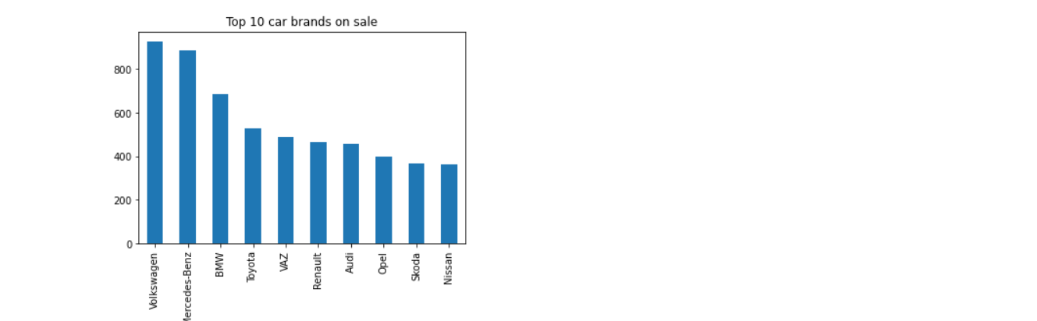
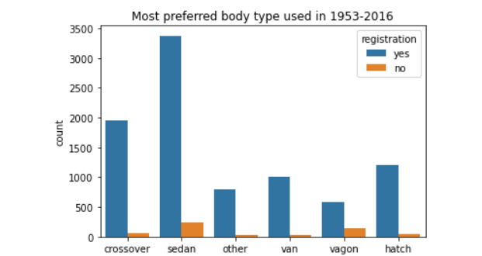
Exploratory Data Analysis (EDA)
While exploring the data, different combinations of features were carried out to find patterns visually and below were the observations
Analysis – Brand and Body Type
Volkswagen and Mercedes-Benz are the top selling brands in cars
People prefer sedan type of body mostly and hence this information can be use for achieving max sale and to figure out production of units

Slide 6
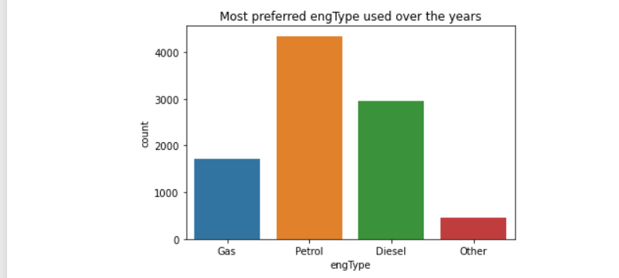
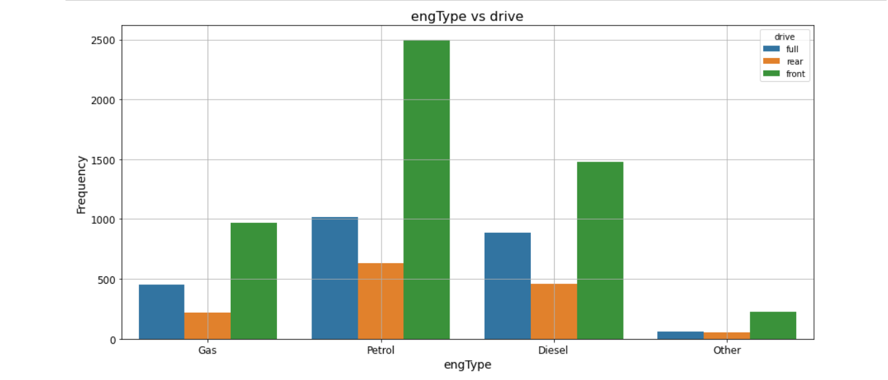
Analysis – Engine Type & Drive
Petrol engine type with front gear is preferred over diesel & gas

Slide 7
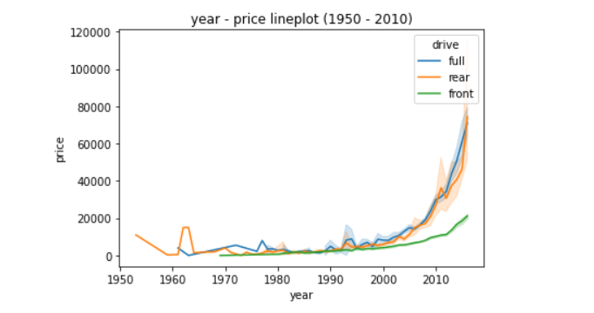
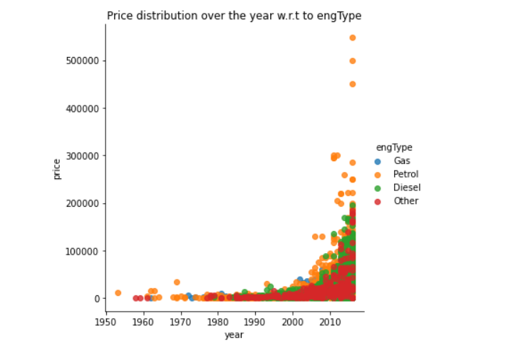
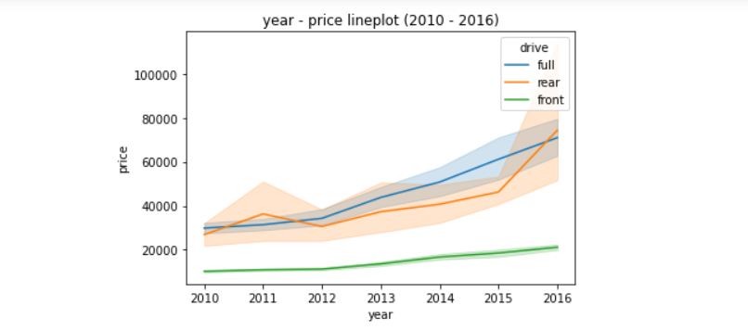
Analysis – Price over years (w.r.t to drive and engine types)
With the time price of the car kept on increasing and 2010 onwards there is high jump observed in the price of car
Over the years, there has been significant increase in prices of “Petrol” cars models as compared to "Gas" and "Diesel"

Slide 8
Conclusion
Inference from the above analysis of car sales dataset:
The three most important features in determining price are body type, mileage, engine type
Most popular car brand is Volkswagen among all.
Sedan continues to be popular car type
Petrol Engine type is the most chosen with the front drive type.
Price of the car has seen the jump in 2010 onwards.
More number of car sales is also observed 2014 onwards.

